Slide 1

Basic Python for Data Science
Python is a powerful programming language that has become popular for data science due to its simplicity and robust libraries like NumPy, Pandas, and Matplotlib.

Slide 2
Importance of Python in AI and ML
Versatile Language: Python's simplicity and readability make it an excellent choice for developing AI and ML models, allowing data scientists to focus on algorithms rather than syntax.
Extensive Libraries: Python offers a vast ecosystem of libraries like NumPy, Pandas, and TensorFlow, which provide powerful tools for data manipulation, analysis, and model building.
Rapid Prototyping: Python's interpreted nature and short development cycle enable quick experimentation and iteration, crucial in the iterative process of AI and ML model development.

Slide 3

Setting Up the Environment
Install Python
Jupyter Notebook
Use the Anaconda distribution for easy installation of Python and data science tools.
Jupyter Notebook allows writing and running Python code interactively in a web browser.

Slide 4
Python Basics
Variables & Data Types
Basic Operations
Collections
Perform arithmetic like addition and multiplication.
Lists store ordered items, dictionaries store key-value pairs.
Variables store data like integers, floats, and strings.

Slide 5

Control Structures
Python has two main types of control structures: conditionals and loops.
Conditionals, like if-else statements, let you control the flow of your program based on certain conditions.
Loops, such as for loops and while loops, allow you to repeat a block of code multiple times. For loops iterate over a collection of items, while loops run until a specific condition becomes false.

Slide 6
Functions
1
Defining Functions
2
Using Functions
Functions are an important part of programming because they allow us to encapsulate code that performs specific tasks. This means that we can write a block of code once and then reuse it multiple times throughout our program without having to write the same code over and over again.
By using functions, we can make our code more modular, easier to read, and more efficient. By encapsulating code into a function, we can easily reuse it throughout our program, making our code more modular and efficient.

Slide 7


NumPy Arrays
Creating Arrays
Array Operations
Arrays are collections of items optimized for numerical operations.An Array is a Data Structure that can be used to store several items of the same data type in a programming language. In Python, you can create an array by importing the Array module and using the array() function. For example, you can create an Array of integers by writing: import array as arr.
Perform operations like adding a number to all elements.The basic operations in the Arrays are insertion, deletion, searching, display, traverse, and update.

Slide 8
Pandas DataFrames
Creating DataFrames
DataFrame Operations
DataFrames are tables with rows and columns, useful for data manipulation.
View data, access specific columns, and generate summary statistics.

Slide 9



Data Analysis Workflow
Load Data
Clean Data
Analyze Data
Import data from files like CSV.
Remove or fill missing values, filter rows based on conditions.
Calculate statistics and group data for comparison.

Slide 10
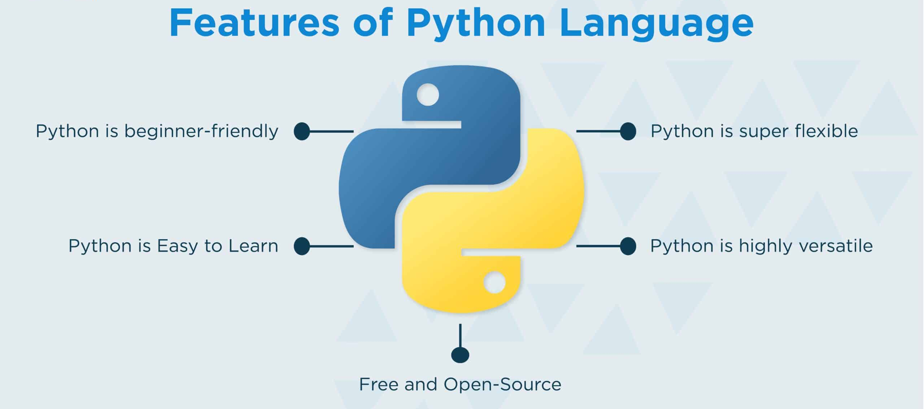
Overview of Python
Python is a versatile and powerful programming language that has become increasingly important in the fields of artificial intelligence and machine learning.
In the realm of artificial intelligence and machine learning, Python has become a go-to language for researchers and practitioners. Libraries like NumPy, SciPy, and Scikit-learn provide powerful tools for numerical and scientific computing, while frameworks like TensorFlow, Keras, and PyTorch enable the development of complex deep learning models. This combination of accessible syntax and powerful capabilities has made Python a preferred choice for AI and ML projects.

Slide 11
Why We Use Python for AI and ML?
Ease of Use: Python's simple and readable syntax makes it an excellent choice for rapid prototyping and iterative development in AI and ML projects.
Extensive Library Support: Python offers a vast ecosystem of libraries and frameworks, such as TensorFlow, Keras, and PyTorch, which provide powerful tools for building sophisticated AI and ML models.
Data Handling Capabilities: Python's data manipulation libraries, like NumPy and Pandas, make it easy to work with large and complex datasets, a critical aspect of AI and ML tasks.
Versatility: Python's versatility allows it to be used for a wide range of AI and ML applications, from computer vision and natural language processing to predictive analytics and reinforcement learning.

